Slide 1
Accelerated RNSD-Jacobi Method for Solving Sylvester’s Equation
Yann-bor Wen
Advisor: Dr. Li Wang
Committee: Dr. Guojun Liao Dr. Ren-Cang Li

Slide 2
Problem Statement
Determine an algorithm that will beat the current Matlab solver function for Sylvester’s equation, AX + XB = C, either by
Faster computation time, or
Minimum residual in x-iterations

Slide 3

Sylvester’s Equation
$AX+XB=C$
where$A∈ℂmxm\text{, }B∈ℂnx\text{n}\text{,} C∈ℂmxn$ satisfy the following conditions:
A, B, and C are large-scale and sparse matrices
At least one of the positive semi-definite matrices A and B is a positive definite matrix
A and –B have no common eigenvalues

Slide 4

Applications
Sylvester's Equation is used throughout control theory, image processing, model reduction, analysis of bilinear systems, matrix eigen-decompositions
Model Reduction: Linear Dynamic Systems
Single Input/Single Output (SISO) and Multiple Input/Multiple Output (MIMO) systems:
VLSI circuits
International Space Station
Image Processing: The restoration of two-dimensional images in the presence of noise
Issues with large-scale systems are storage, speed, accuracy
Notes:
Models of dynamical systems are useful primarily for simulation and control.
Very-large-scale integration (VLSI) is the process of creating an integrated circuit (IC) by combining millions of transistors or devices into a single chip.
ISS compsed of many modules. Each module are described in terms of n ≈ 103 state variables. The goal is to develop controllers that are implemented onboard the space station. Consequently, controllers oflowcomplexity are needed.

Slide 5
Direct or Iterative Methods
When matrices A and B are small and dense, direct methods are attractive. Generally, transforming A and B into triangular or Hessenberg form, then solving by back-substitution
When matrices A and B are large and sparse, as often in practice, iterative methods are more efficient

Slide 6
Current MATLAB Function
Bartels-Stewart Method:
Apply Schur decomposition A=Q^{T}RQ
Q is unitary, R is upper or lower triangular
Solve by forward or backward substitution

Slide 7
Iterative Algorithms Studied
Krylov Subspace Methods
Conjugate Gradient, MCG
Jacobi CG, Modified Jacobi
Arnoldi
Projection Methods
RNSD, MRNSD
Skew-Hermitian Splitting Method
HSS
PSS
GMRES
Notes:
1952, Hestenes and Stiefel – Conjugate Gradient for symmetric pos def linear systems
Saad. Y 1986 GMRES – to solve asymmetric matrices and less storage space
1995 RNSD, 2015 MRNSD
2003 Hermitian skew-Hermitian method developed Bai Zhongzhi
2007 Jacobi - W. Fan, C. Gu, Z. Tian
2010 Arnoldi- DATTA, HEYOUNI2, JBILOU
2013 PSS improved speed and least iterations

Slide 8

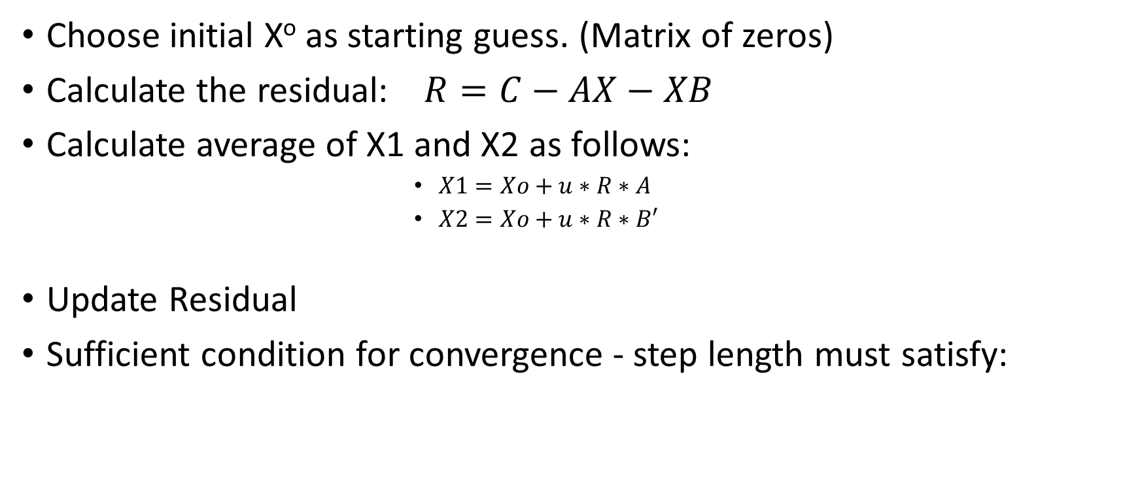
Conjugate Gradient Based Method
Choose initial Xº as starting guess. (Matrix of zeros)
Calculate the residual: $R=C−AX−XB$
Calculate average of X1 and X2 as follows:
$X1=Xo+u∗R∗A$
$X2=Xo+u∗R∗B′$
Update Residual
Sufficient condition for convergence - step length must satisfy:
Notes:
Talk about theory and history behind it

Slide 9
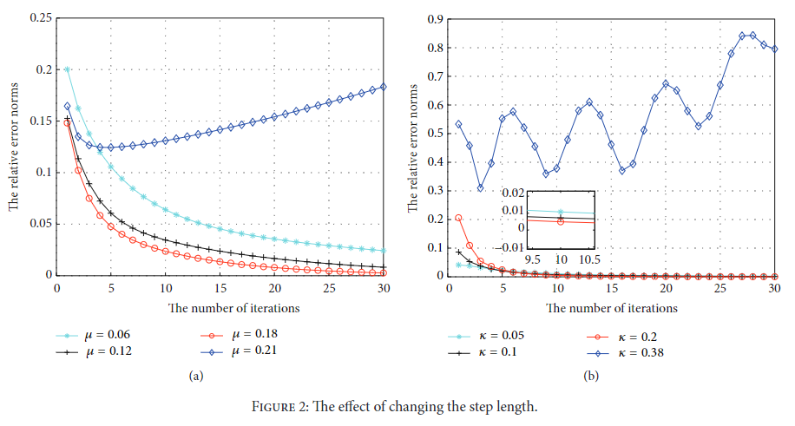
Step Length
[3]

Slide 10
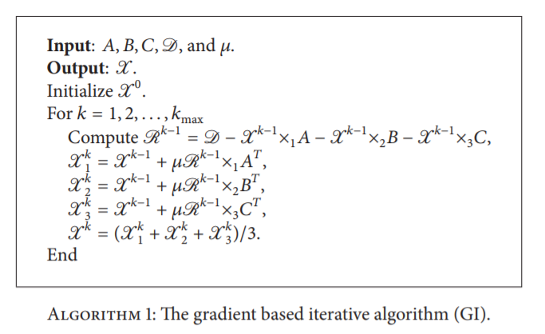
Conjugate Gradient Method
Notes:
For tensor equation. Sylvester’s equation is just 2 dimension matrix version.

Slide 11
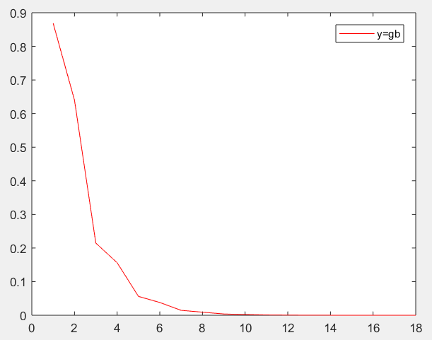





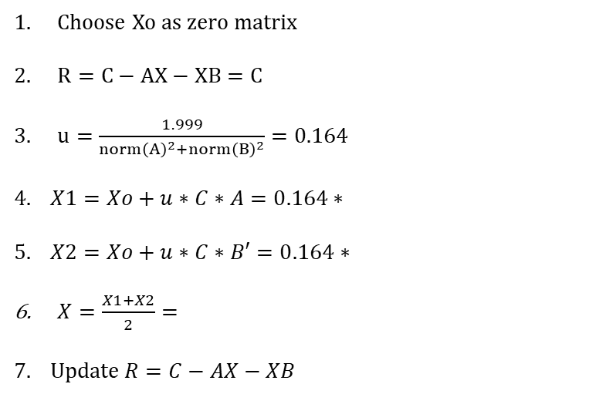

Conjugate Gradient Method
Example
$$\left[\begin{matrix}3 & 1 \\ −1 & 2\end{matrix}\right]$$
$$\left[\begin{matrix}1 & 1 \\ −1 & 1\end{matrix}\right]$$
$$\left[\begin{matrix}1 & 0 \\ 1 & −2\end{matrix}\right]$$
A= B= C=
Residual Plot
Choose Xo as zero matrix
$R=C−AX−XB=C$
$u=\frac{1.999}{norm{\left(A\right)}^{2}+norm{\left(B\right)}^{2}}=0.164$
$4. X1=Xo+u∗C∗A=0.164∗$
$5. X2=Xo+u∗C∗B′=0.164∗$
$X=\frac{X1+X2}{2}=$
$$7. Update R=C−AX−XB$$
$$\left[\begin{matrix}3 & 1 \\ 5 & −3\end{matrix}\right]$$
$$\left[\begin{matrix}4 & −2 \\ 1 & 3\end{matrix}\right]$$
$$\left[\begin{matrix} .3279 & 0 \\ .3279 & .4919\end{matrix}\right]$$
Error = norm(R)
Convergence 10e-6 reached in 18 iterations

Slide 12
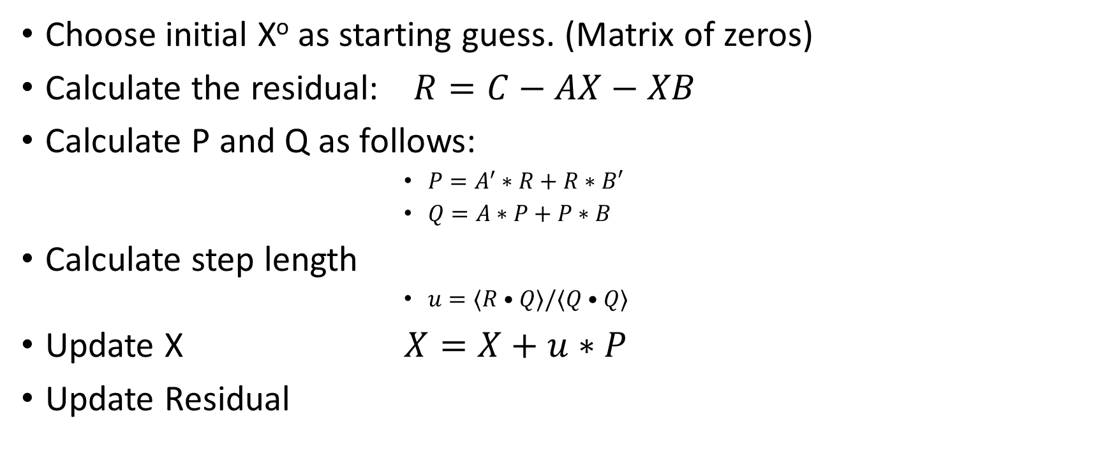
Residual Norm Steepest Descent (RNSD)
Choose initial Xº as starting guess. (Matrix of zeros)
Calculate the residual: $R=C−AX−XB$
Calculate P and Q as follows:
$P=A^{′}∗R+R∗B′$
$Q=A∗P+P∗B$
Calculate step length
$u=⟨R•Q⟩/⟨Q•Q⟩$
Update X $X=X+u∗P$
Update Residual
Notes:
Positive def condition is relaxed. A is square nonsingular matrix

Slide 13
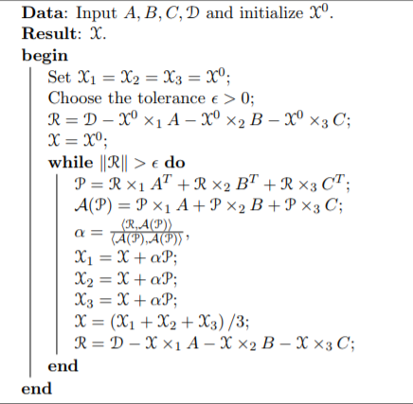
Residual Norm Steepest Descent (RNSD)
ALGORITHM 2. The Residual Norm Steepest Descent

Slide 14
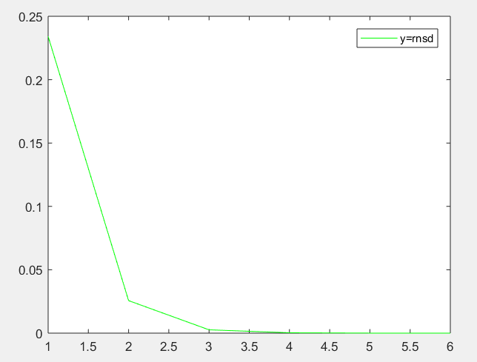



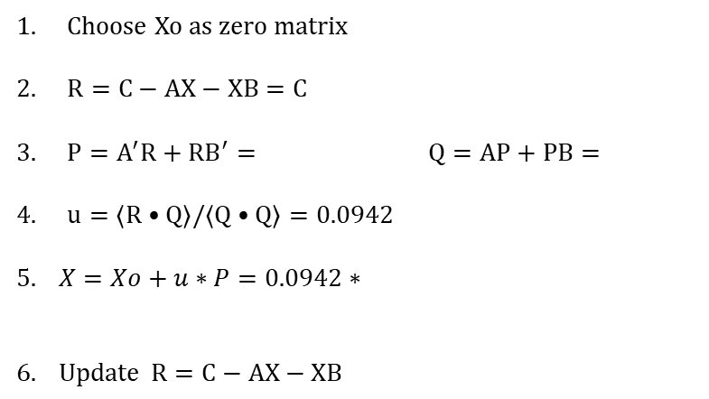
Residual Norm Steepest Descent (RNSD)
Example
$$\left[\begin{matrix}3 & 1 \\ −1 & 2\end{matrix}\right]$$
$$\left[\begin{matrix}1 & 1 \\ −1 & 1\end{matrix}\right]$$
$$\left[\begin{matrix}1 & 0 \\ 1 & −2\end{matrix}\right]$$
A= B= C=
Residual Plot
Choose Xo as zero matrix
$R=C−AX−XB=C$
$P=A^{′}R+RB^{′}= Q=AP+PB=$
$u=⟨R•Q⟩/⟨Q•Q⟩=0.0942$
$5. X=Xo+u∗P=0.0942∗$
$$6. Update R=C−AX−XB$$
$$\left[\begin{matrix}3 & 1 \\ 2 & −7\end{matrix}\right]$$
$$\left[\begin{matrix}13 & 0 \\ 10 & −20\end{matrix}\right]$$
$$\left[\begin{matrix}3 & 1 \\ 2 & −7\end{matrix}\right]$$
Error = norm(R)
Convergence 10e-6 reached in 6 iterations

Slide 15
Modified CG and RNSD
Updates X after every calculation of X1 and X2
RNSD updates R=C-AX-XB after every calculation of X
Convergence Criteria for Modified CG

Slide 16
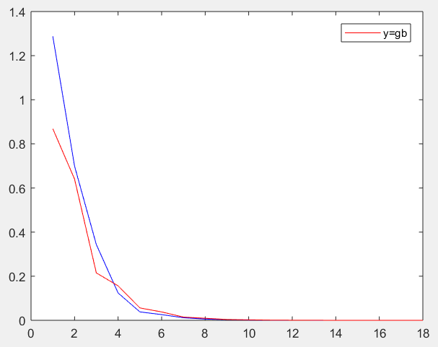
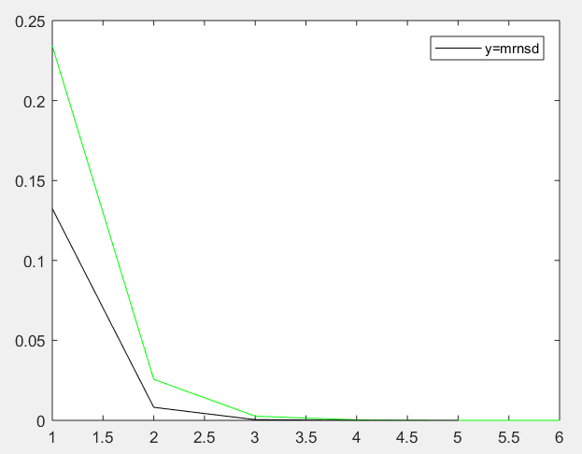
Modified CG and RNSD
Iterations: CG=18, MCG=17 Iterations: RNSD=6, MRNSD=5
Residual Plots

Slide 17
Positive-Definite Skew-Hermitian Splitting (PSS)
In 2003, Bai Zhongzhi proposed HSS iterative method
In 2011, HSS was applied to solve Sylvester’s equation
In 2013, Wang Xiang developed PSS iterative method, based off HSS
Conditions for A, B, and C: [7]
(I) A, B, and C are large-scale and sparse matrices
(II) At least one of A and B is a non-Hermitian matrix
(III) At least one of the positive semidefinite matrices A and B is positive definite
Notes:
It is well known that for any non-Hermitian matrix A there exists a unitary matrix U that transforms it to upper triangular form
T=U∗AU.

Slide 18

Positive-Definite Skew-Hermitian Splitting (PSS)
Hermitian matrix: (self-adjoint matrix) is a complex matrix that is equal to its own conjugate transpose
Skew-Hermitian matrix: a complex matrix that is equal to the negative of its own conjugate transpose
We can split A into its Hermitian and skew-Hermitian parts
$$A=H+S$$
$$where H=\frac{1}{2}\left(A+A∗\right) and S=\frac{1}{2}(A−A∗)$$

Slide 19


Positive-Definite Skew-Hermitian Splitting (PSS)
We can say H is positive definite as both A and B are positive semi-definite, and one of them is positive definite [7]
$$where αj are given non−negative constants and βj are positive constants$$
We can rewrite Sylvester’s equation as

Slide 20
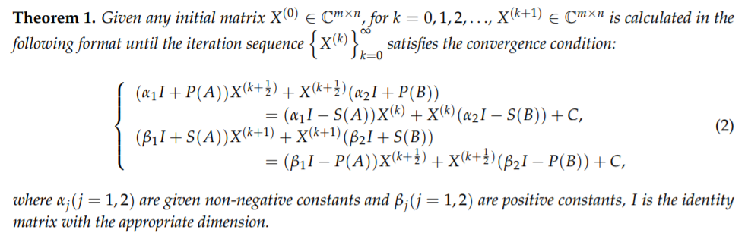
Positive-Definite Skew-Hermitian Splitting (PSS)

Slide 21
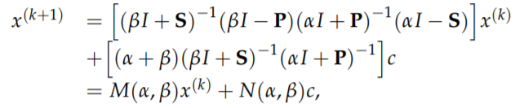
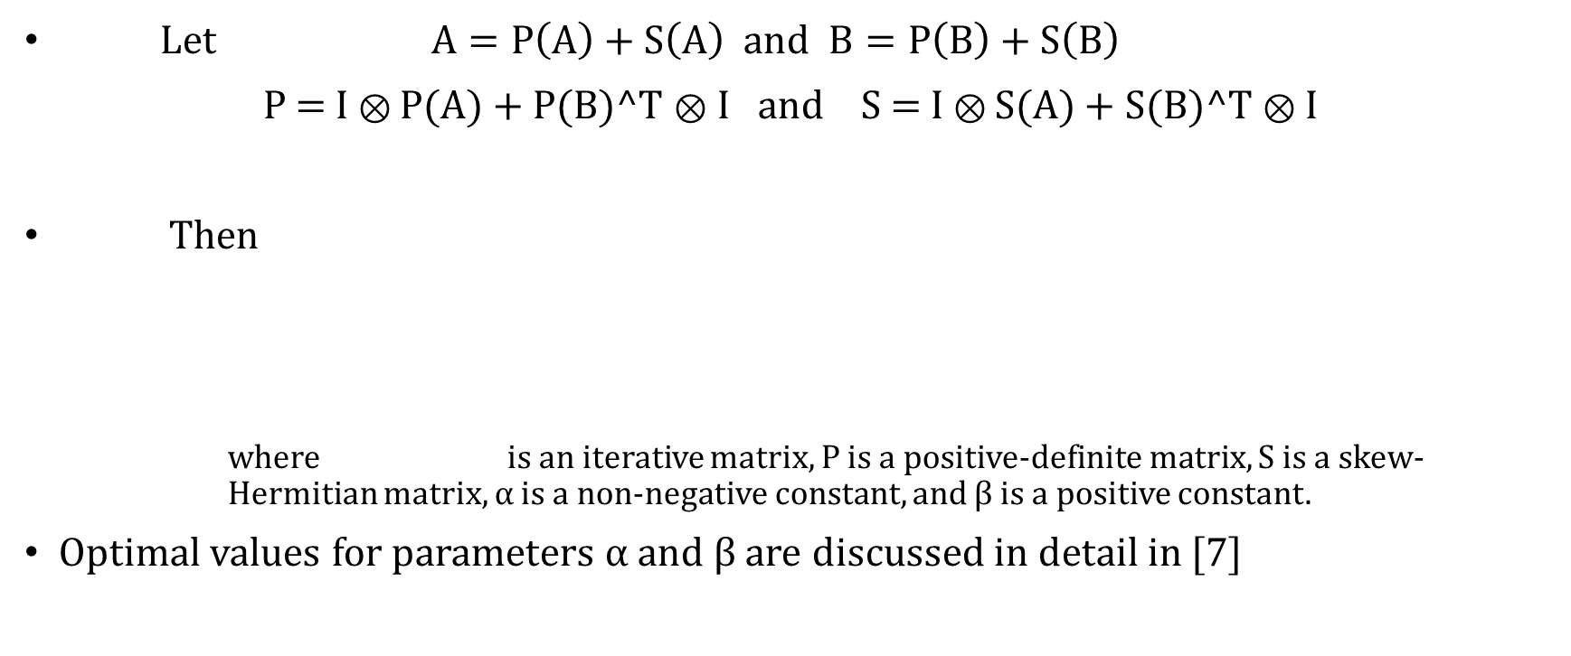
Positive-Definite Skew-Hermitian Splitting (PSS)
Let $A=P\left(A\right)+S\left(A\right)$ and $B=P\left(B\right)+S\left(B\right)$
P = I ⊗ P(A) + P(B)^T ⊗ I and S = I ⊗ S(A) + S(B)^T ⊗ I
Then
where is an iterative matrix, P is a positive-definite matrix, S is a skew-Hermitian matrix, α is a non-negative constant, and β is a positive constant.
Optimal values for parameters α and β are discussed in detail in [7]

Slide 22
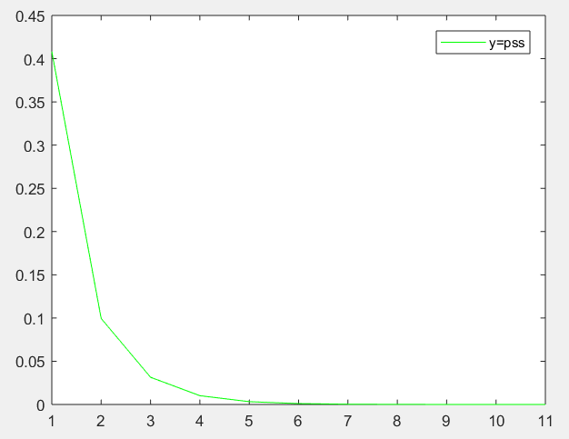
Positive-Definite Skew-Hermitian Splitting (PSS)
Example
$$\left[\begin{matrix}3 & 1 \\ −1 & 2\end{matrix}\right]$$
$$\left[\begin{matrix}1 & 1 \\ −1 & 1\end{matrix}\right]$$
$$\left[\begin{matrix}1 & 0 \\ 1 & −2\end{matrix}\right]$$
A= B= C=
Residual Plot
Error = norm(R)
Convergence 10e-6 reached in 11 iterations

Slide 23
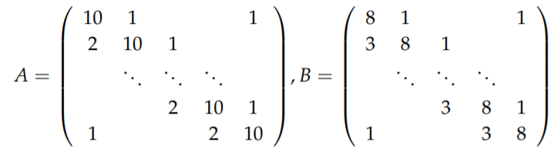
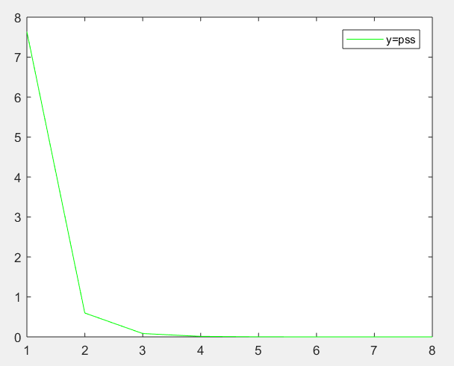
Positive-Definite Skew-Hermitian Splitting (PSS)
Example
n=12
C = random(n,n)
Residual Plot
Convergence 10e-6 reached in 8 iterations

Slide 24
Other Methods Tested
GMRES
Arnoldi
Jacobi Gradient Based and Modified Jacobi
HSS

Slide 25
Algorithm Comparison
Jacobi Gradient Based method and RNSD took least CPU time overall
PSS took least iterations however the longest computation time
Applied idea behind Jacobi Gradient Based method to the RNSD method
Method | CPU Time | Iterations
Lyapunov | 0.00000
Jacobi GB | 0.06250 | 20
RNSD | 0.01562 | 32
MRNSD | 0.04687 | 19
PSS | 0.14063 | 8
Trial on n=12, sparse matrices

Slide 26

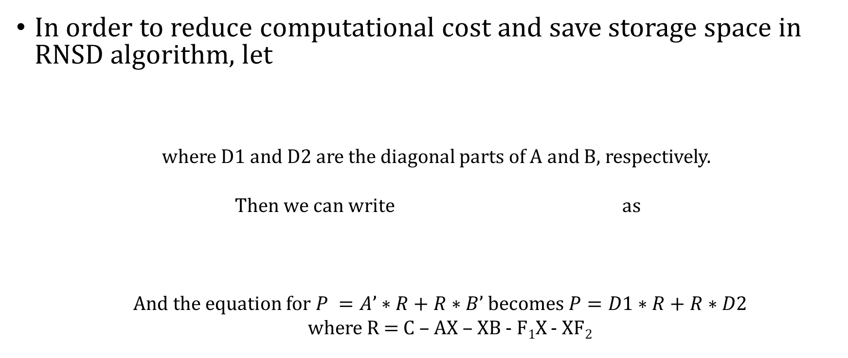
Proposed Accelerated RNSD-Jacobi Method
In order to reduce computational cost and save storage space in RNSD algorithm, let
where D1 and D2 are the diagonal parts of A and B, respectively.
Then we can write as
And the equation for $P =A’∗R+R∗B’$becomes $P=D1∗R+R∗D2$
where R = C – AX – XB - F₁X - XF₂

Slide 27





Proposed Method Accelerated RNSD-Jacobi Method
$$−F1X−XF2$$
$$D1$$
$$D2$$
$$D3$$
ALGORITHM 4. The Accelerated RNSD-Jacobi Method
$$−F1X−XF2$$

Slide 28
Numerical Experiments
n = 16, 32, 64, 128, 256, 500, 800 sparse tridiagonal matrices A and B
We compare the built-in Lyapunov, Jacobi, RNSD, MRNSD, PSS, and proposed RNSD-Jacobi methods

Slide 29
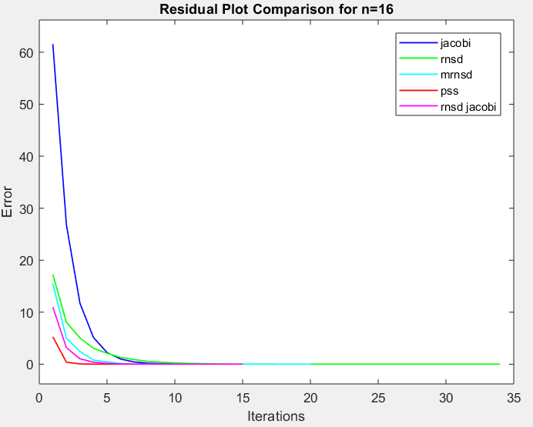
Numerical Experiments
Method | CPU Time | Iterations
Jacobi | 0.28125 | 20
RNSD | 0.06250 | 34
MRNSD | 0.06250 | 20
PSS | 0.28125 | 8
RNSD-Jacobi | 0.03125 | 15
Lyapunov | 0.03125

Slide 30
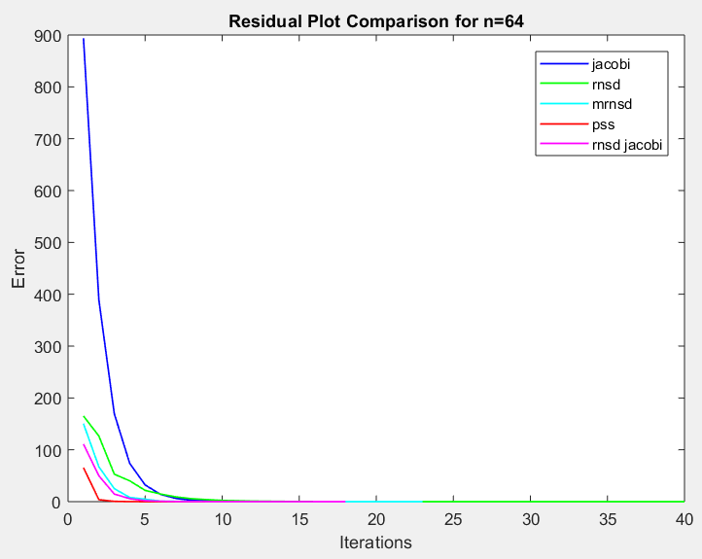
Numerical Experiments
Method | CPU Time | Iterations
Jacobi | 0.32813 | 24
RNSD | 0.23438 | 40
MRNSD | 0.15625 | 23
PSS | 217.53125 | 9
RNSD-Jacobi | 0.06250 | 18
Lyapunov | 0.06250

Slide 31
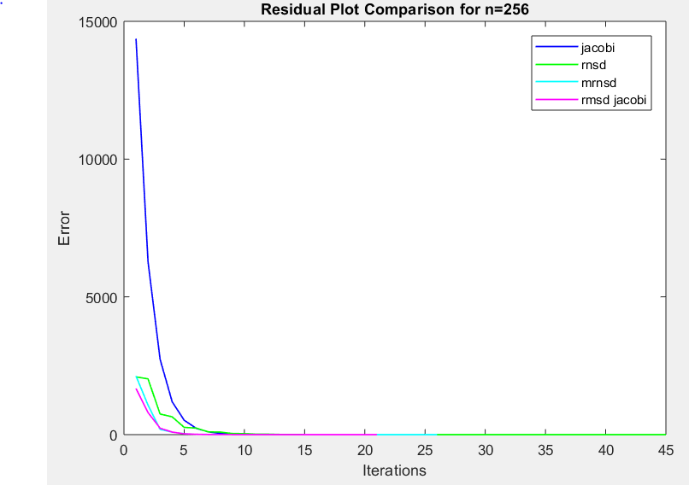
Numerical Experiments
Method | CPU Time | Iterations
Jacobi | 0.9375 | 27
RNSD | 1.4688 | 45
MRNSD | 1.3750 | 26
RNSD-Jacobi | 0.8281 | 21
Lyapunov | 0.8906

Slide 32
Numerical Experiments
Method | CPU n=16 | CPU n=64 | CPU n=256 | CPU n=500 | CPU n=800
Jacobi | 0.28125 | 0.32813 | 0.9375 | 4.5781 | 13.7031
RNSD | 0.0625 | 0.23438 | 1.4688 | 7.2969 | 24.1719
MRNSD | 0.0625 | 0.15625 | 1.375 | 6.75 | 22.7969
PSS | 0.28125 | 217.53125
RNSD-Jacobi | 0.03125 | 0.06250 | 0.8281 | 3.9531 | 13.3438
Lyapunov | 0.03125 | 0.06250 | 0.8906 | 4.4219 | 14.5

Slide 33
Numerical Experiments
Method | Iterations n=16 | Iterations n=64 | Iterations n=256 | Iterations n=500 | Iterations n=800
Jacobi | 20 | 24 | 27 | 29 | 30
RNSD | 34 | 40 | 45 | 49 | 51
MRNSD | 20 | 23 | 26 | 27 | 29
PSS | 8 | 9
RNSD-Jacobi | 15 | 18 | 21 | 22 | 23

Slide 34
Conclusion
Lyapunov is effective for solving Sylvester’s equation with dense matrices
RNSD-Jacobi method minimizes CPU time and memory and takes the 2nd least number of iterations
PSS method takes the least iterations to reach a residual value
PSS method also takes the most memory and longest CPU time to run
Challenges with computation power for study of larger matrices

Slide 35
Thank You
References
[1] Azizi Zadeh, Najmeh & Tajaddini, Azita & Wu, Gang. (2017). A weighted global GMRES algorithm with deflation for solving large Sylvester matrix equations. Numerical Algorithms. 10.1007/s11075-018-0597-9.
[2] Zhen Ch Baur, U., & Benner, P. (2008). Cross-Gramian based model reduction for data-sparse systems. Electronic Transactions on. Numerical Analysis, 31, 256–270
[3] Zheng Chen and Linzhang Lu, “A Gradient Based Iterative Solutions for Sylvester Tensor Equations,” Mathematical Problems in Engineering, vol. 2013, Article ID 819479, 7 pages 2013.
[4] Tian, Z.L. & Tian, Maoyi & Gu, Chuanqing & Hao, Xiaoning. (2017). An accelerated Jacobi-gradient based iterative algorithm for solving sylvester matrix equations. Filomat. 31. 2381-2390. 10.2298/FIL1708381T.
[5] Datta, B.N & Heyouni, Mohammed & Jbilou, Khalide. (2010). The global Arnoldi process for solving the Sylvester-Observer equation. Computational and Applied Mathematics. 29. 527-544. 10.1590/S1807-03022010000300012.
[6] Wang, Xiang & Li, Yan & Dai, Lin. (2013). On Hermitian and skew-Hermitian splitting iteration methods for the linear matrix equation AXB=CAXB=C. Computers & Mathematics with Applications. 65. 657–664. 10.1016/j.camwa.2012.11.010.
[7] On positive-definite and skew-Hermitian splitting iteration methods for continuous Sylvester equation AX + XB = CWang X., Li W.-W., Mao L.-Z. (2013) Computers and Mathematics with Applications, 66 (11) , pp. 2352-2361.
[8] Shen, Hai-Long & Li, Yan-Ran & Shao, Xin-Hui. (2019). The Four-Parameter PSS Method for Solving the Sylvester Equation. Mathematics. 7. 105. 10.3390/math7010105.
[9] Y. Saad, Iterative Methods for Sparse Linear Systems, PWS press, New York, 1995

